Slide 1
Development of a sample To-Do Application
Subtitle : Using python for CRUD Operation
Name : GUNREDDY NIKHIL REDDY
Date : September-11-2024

Slide 2
Project Overview
Objective:
Develop a simple To-Do List application using Python.
Functionalities:
Add, Edit, Delete, and View tasks.
Learning Goals:
Gain fundamental understanding of Python programming.
Learn data handling and basic CRUD operations.

Slide 3
Functional Requirements
Add Tasks
View Tasks
Edit Tasks
Delete Tasks

Slide 4
Project Architecture
Install IDE,python
Testing and Debugging
Git hub
Design Application

Slide 5
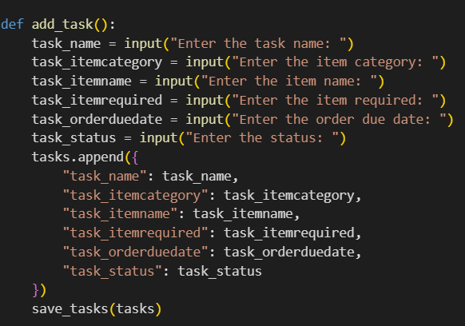
Design Application
Add tasks:-

Slide 6
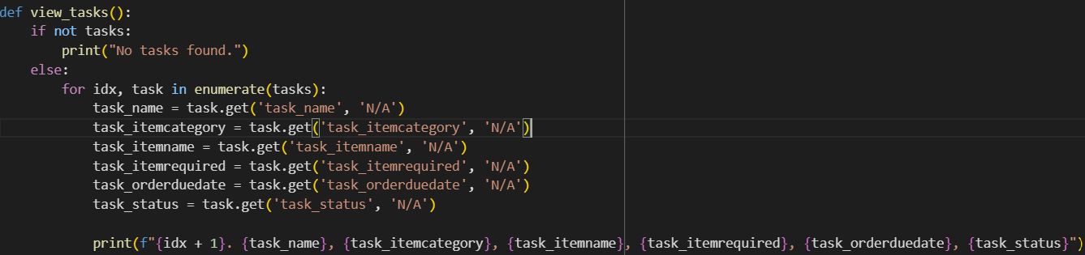
Design Application
View tasks:-

Slide 7
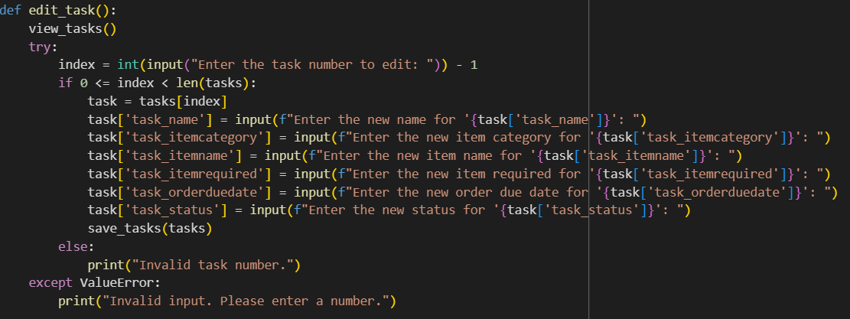
Design Application
Edit tasks:-

Slide 8
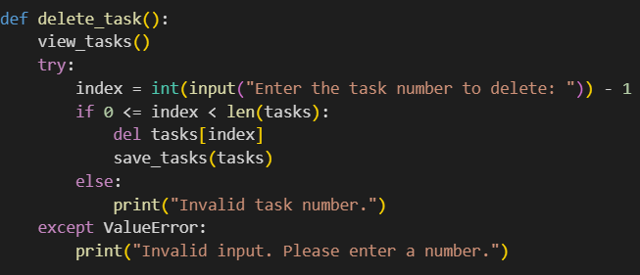
Design Application
Delete tasks:-

Slide 9
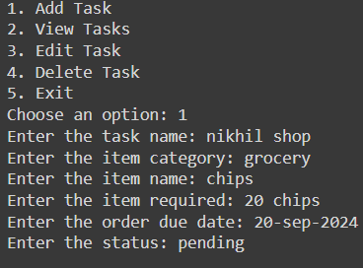
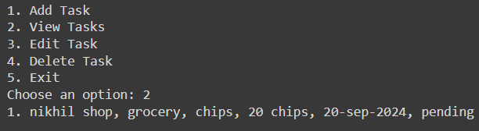
Testing & Debugging
View tasks output
Add tasks output

Slide 10
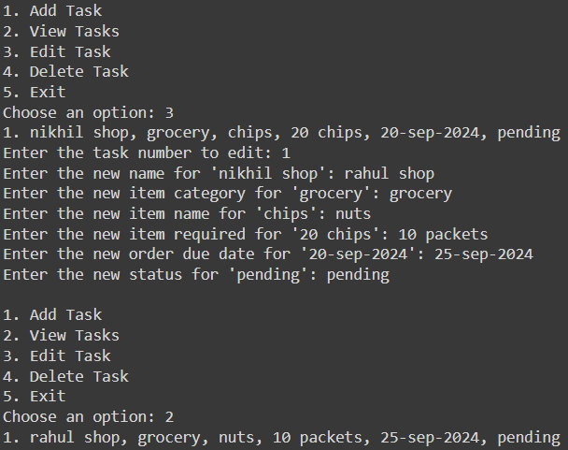
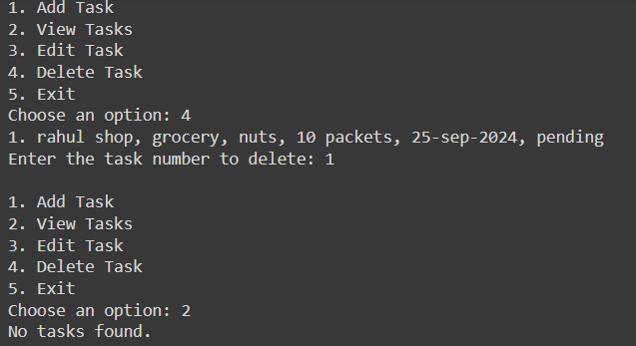
Testing & Debugging
Delete tasks
Edit tasks output

Slide 11
Challenges Faced
Attempted to execute Python code in Visual Studio Code.
Encountered issues with Visual Studio Code configuration.
Troubleshooting the problem did not resolve the issue.
Decided to switch to Google Colab for execution.
Imported necessary libraries in Google Colab.
Uploaded required files and ensured all dependencies were met.
Successfully ran the Python code.
Output generated as expected.
Successfully completed execution in Google Colab without further issues.
Visual Studio Code may need a deeper configuration fix (to investigate).
Google Colab offers a good backup environment for running Python code.

Slide 12
Learning
Create Application Framework: Set up project structure and core modules.
Build Basic Functionality: Implement CRUD operations for task management and integrate data storage. Integrate Advanced Capabilities: Add features like task prioritization and optimize performance.
Conduct Testing and Debugging: Test, debug, and handle edge cases. Update and Maintain Git Repository: Commit changes, manage branches, and push updates.

Slide 13
Thank you

